Slide 1
Chapter 4 Organic Compounds: Cycloalkanes and Their Stereochemistry

Slide 2
Learning Objectives
(4.1)
Naming cycloalkanes
(4.2)
Cis-trans isomerism in cycloalkanes
(4.3)
Stability of cycloalkanes: Ring strain
(4.4)
Conformations of cycloalkanes
(4.5)
Conformations of cyclohexane

Slide 3
Learning Objectives
(4.6)
Axial and equatorial bonds in cyclohexane
(4.7)
Conformations of monosubstituted cyclohexanes
(4.8)
Conformations of disubstituted cyclohexanes
(4.9)
Conformations of polycyclic molecules

Slide 4
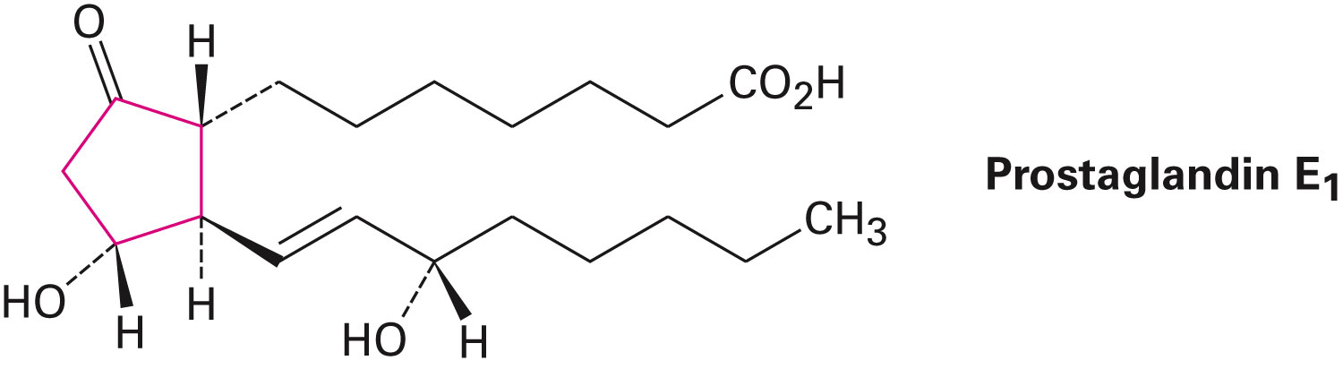
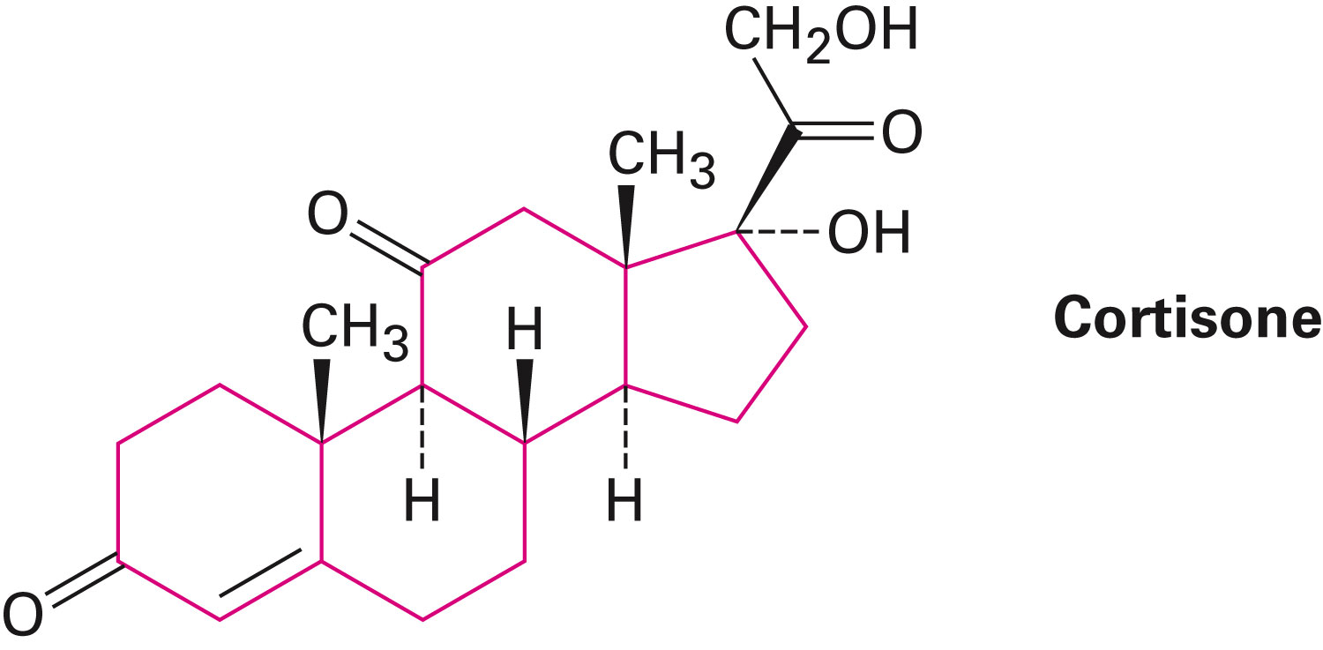
Organic Compounds: Open-Chained or Cyclic
Number of organic compounds contain rings of carbon atoms
Example
Prostaglandins
Steroids

Slide 5
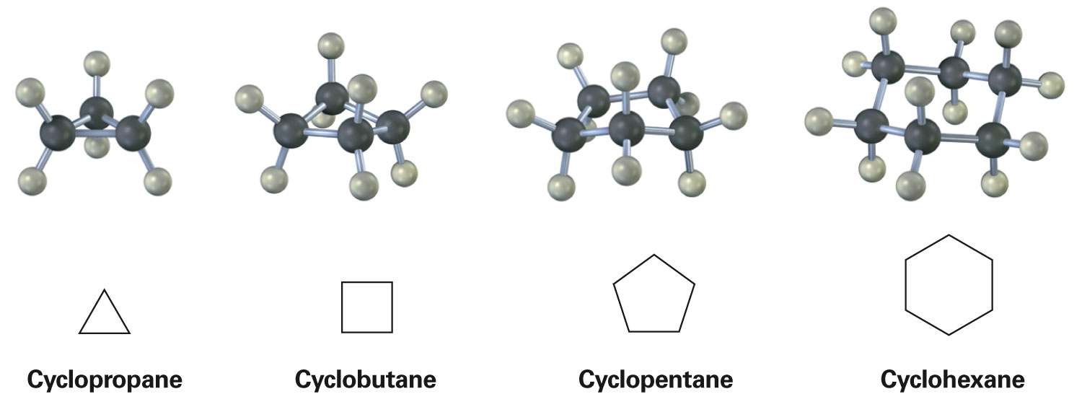
Naming Cycloalkanes
Cycloalkanes or alicyclic compounds: Saturated cyclic hydrocarbons
General formula (C_{n}H_{2n})
Can be represented using skeletal drawings
Notes:
Naming cycloalkanes

Slide 6
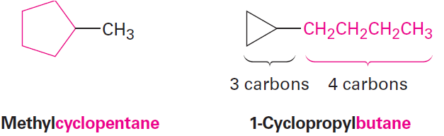
Steps in Naming Cycloalkanes
Find the parent
Count the number of carbons in the ring
Count the number in the largest substituent
Notes:
Naming cycloalkanes

Slide 7
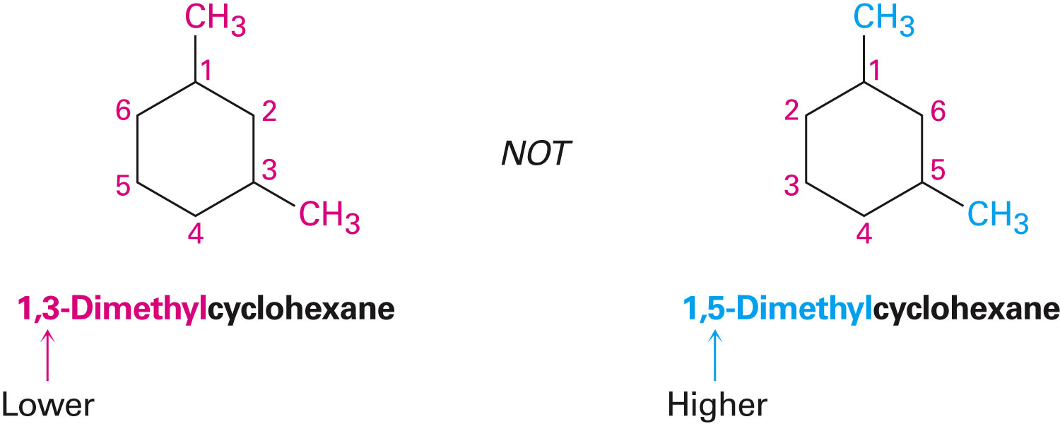
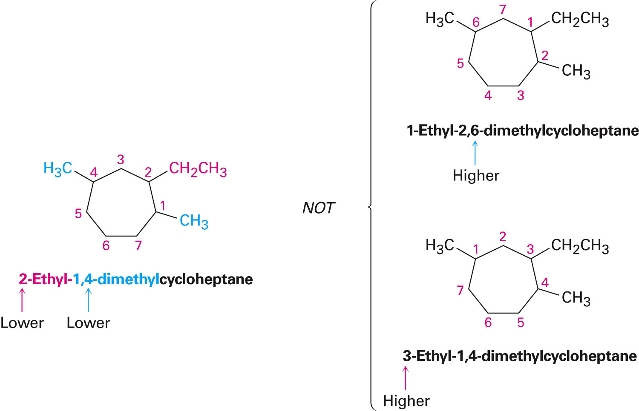
Steps in Naming Cycloalkanes
Number the substituents
Write the name
Notes:
Naming cycloalkanes

Slide 8
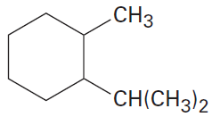
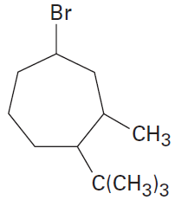
Worked Example
Give IUPAC names for the following cycloalkanes
a)
b)
Notes:
Naming cycloalkanes

Slide 9
Worked Example
Solution:
a)
b)
1-Isopropyl-2-methylcyclohexane
4-Bromo-1-tert-butyl-
2-methylcycloheptane
Notes:
Naming cycloalkanes

Slide 10
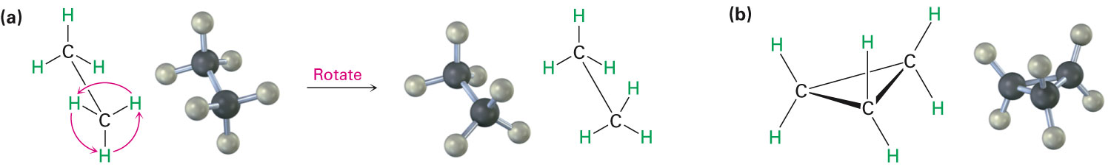
Cis-Trans Isomerism in Cycloalkanes
Cycloalkanes are less flexible than open-chain alkanes
Significantly lesser conformational freedom in cycloalkanes
Notes:
Cis-trans isomerism in cycloalkanes

Slide 11
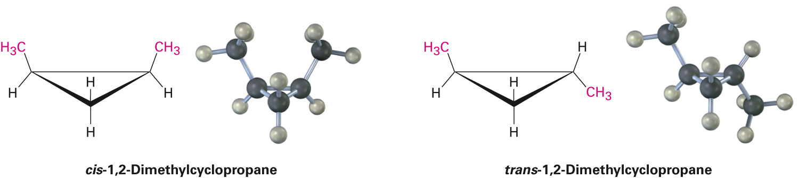
Cis-Trans Isomerism in Cycloalkanes
Cycloalkanes have two faces, when viewed edge-on, owing to their cyclic structure
Top face and bottom face
Isomerism is possible in substituted cycloalkanes
Example - There are two different 1,2-dimethylcyclopropane isomers
Notes:
Cis-trans isomerism in cycloalkanes

Slide 12
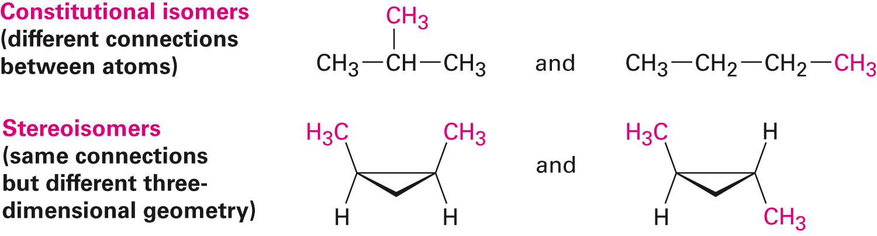
Cis-Trans Isomerism in Cycloalkanes
Stereoisomerism: Compounds which have their atoms connected in the same order but differ in 3-D orientation
Stereochemistry: Term used to refer to the three-dimensional aspects of chemical structure and reactivity
Notes:
Cis-trans isomerism in cycloalkanes

Slide 13
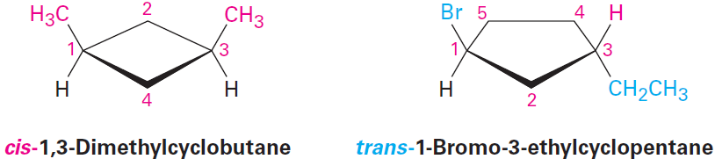
Cis-Trans Isomerism in Cycloalkanes
Cis-trans isomers: Stereoisomers that differ in their stereochemistry about a ring or double bond
Common occurrence in substituted cycloalkanes and several cyclic biological molecules
Notes:
Cis-trans isomerism in cycloalkanes

Slide 14
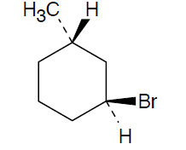
Worked Example
Draw the structures of the following molecules:
a) trans-1-Bromo-3-methylcyclohexane
b) cis-1,2-Dimethylcyclobutane
Solution:
a) trans-1-Bromo-3-methylcyclohexane
Notes:
Cis-trans isomerism in cycloalkanes

Slide 15
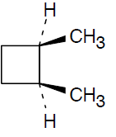
Worked Example
b) cis-1,2-Dimethylcyclobutane
Notes:
Cis-trans isomerism in cycloalkanes

Slide 16
Stability of Cycloalkanes: Ring Strain
Angle strain: Induced in a molecule when bond angles are forced to deviate from the ideal 109°tetrahedral value
Cyclic molecules can assume nonplanar conformations to minimize angle strain and torsional strain by ring-puckering
Torsional strain - Caused due to eclipsing of bonds between neighboring atoms
Steric strain - Caused due to repulsive interactions when atoms approach each other too closely
Notes:
Stability of cycloalkanes: Ring strain

Slide 17
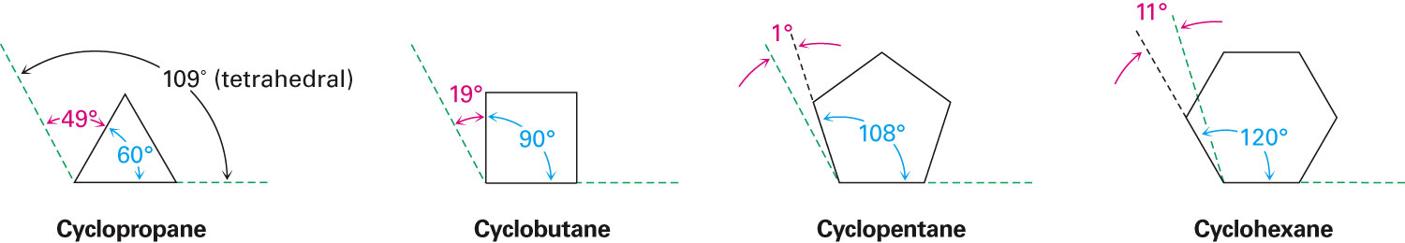
Stability of Cycloalkanes: Ring Strain
Larger rings have many more possible conformations than smaller rings
More difficult to analyze
Notes:
Stability of cycloalkanes: Ring strain

Slide 18
Worked Example
Each H ↔ H eclipsing interaction in ethane costs about 4.0 kJ/mol
How many such interactions are present in cyclopropane?
What fraction of the overall 115 kJ/mol (27.5 kcal/mol) strain energy of cyclopropane is due to torsional strain?
Notes:
Stability of cycloalkanes: Ring strain

Slide 19
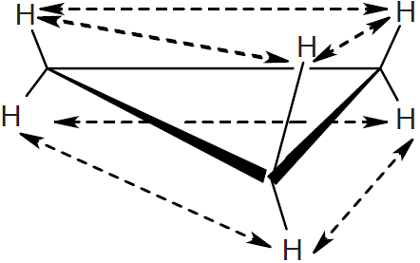
Worked Example
Solution:
Hydrogen atoms on the same side of the cyclopropane ring are eclipsed by neighboring hydrogens
Six eclipsing interactions, three on each side of the ring
Notes:
Stability of cycloalkanes: Ring strain

Slide 20
Worked Example
Cost of six interactions = 4.0 kJ/mol ×6
= 24.0 kJ/mol
Percentage of total strain energy of cyclopropane
due to torsional strain
= 21 %
Notes:
Stability of cycloalkanes: Ring strain

Slide 21
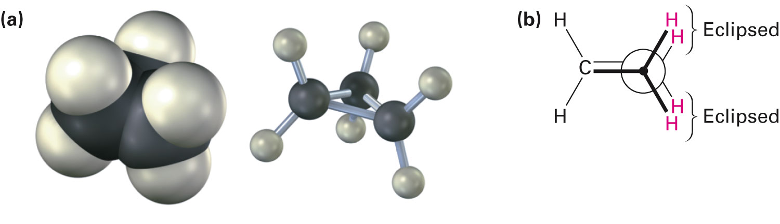
Conformations of Cycloalkanes
Cyclopropane
Most strained of all rings due to angle strain caused by its C–C–C bond angles of 60°
Has considerable torsional strain
Has bent bonds
C–H bonds are eclipsed
Notes:
Conformations of cycloalkanes

Slide 22
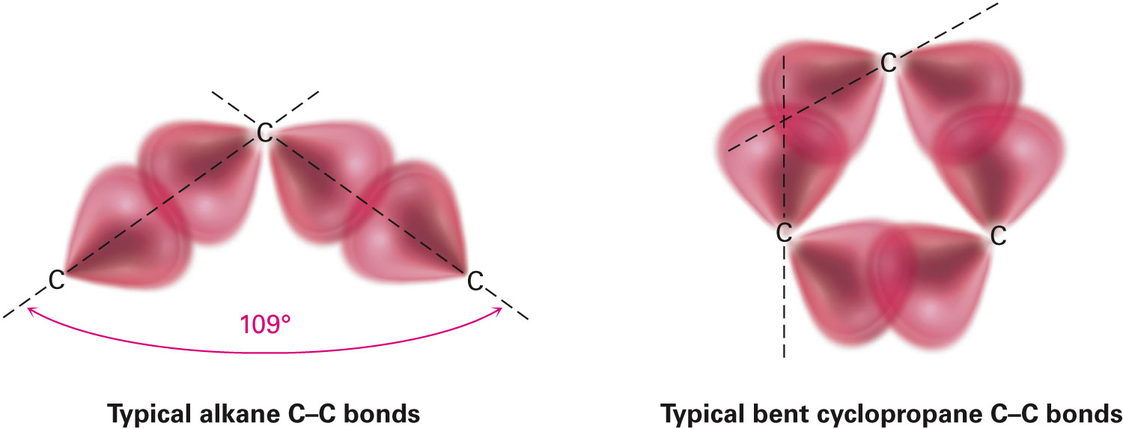
Conformations of Cycloalkanes
Cyclopropane bonds are weaker and more reactive than typical alkane bonds
Notes:
Conformations of cycloalkanes

Slide 23
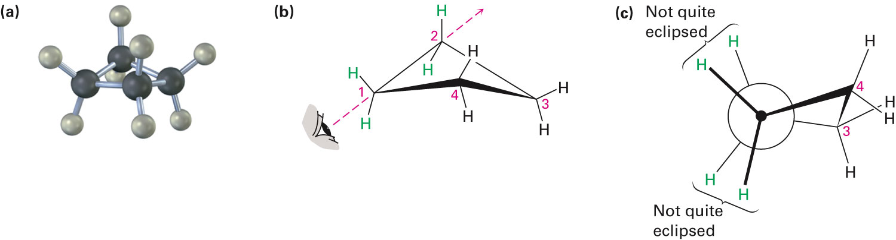
Conformations of Cycloalkanes
Cyclobutane
Has less angle strain than cyclopropane
More torsional strain because of larger number of ring hydrogens, and their proximity to each other
Slightly bent out of plane, one carbon atom is about 25°above the plane
Increases angle strain but decreases torsional strain
Notes:
Conformations of cycloalkanes

Slide 24
Conformations of Cycloalkanes
Cyclopentane
No angle strain
Large torsional strain
Non planar conformations strike balance between increased angle strain and decreased torsional strain
Four carbon atoms are approximately in the same plane
Fifth carbon atom is bent out of the plane
Notes:
Conformations of cycloalkanes

Slide 25
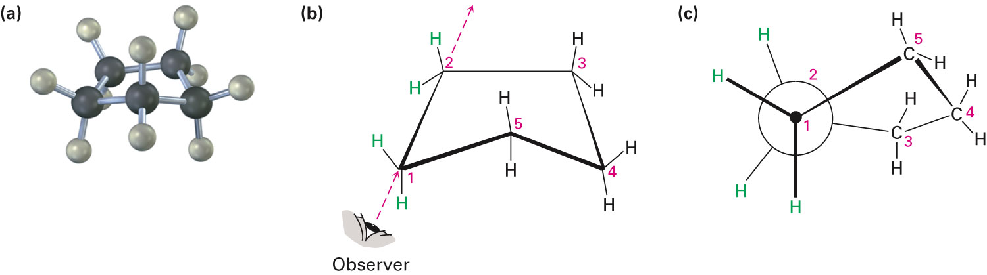
Figure 4.6 - The Conformation of Cyclopentane
Notes:
Conformations of cycloalkanes

Slide 26
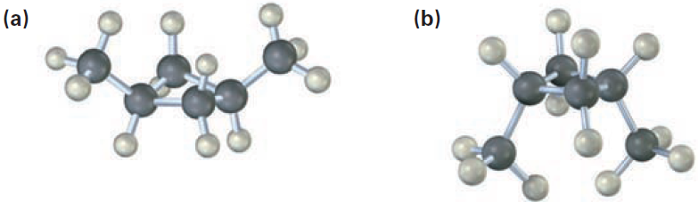
Worked Example
Two conformations of cis-1,3-dimethylcyclobutane are shown
What is the difference between them?
Which one is likely to be more stable?
Notes:
Conformations of cycloalkanes

Slide 27
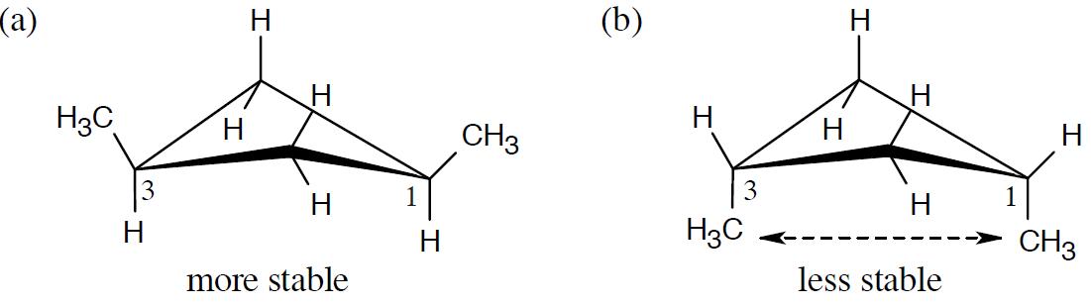
Worked Example
Solution:
The methyl groups are farther apart in the more stable conformation of cis-1,3 dimethylcyclobutane
Notes:
Conformations of cycloalkanes

Slide 28
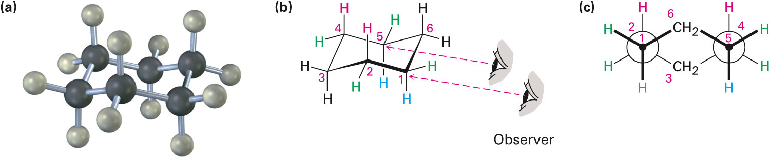
Conformations of Cyclohexane
Occur widely in nature
Adopts chair conformation
Chair conformation: Strain-free, three-dimensional shape
Has neither angle strain nor torsional strain
Notes:
Conformations of cyclohexane

Slide 29
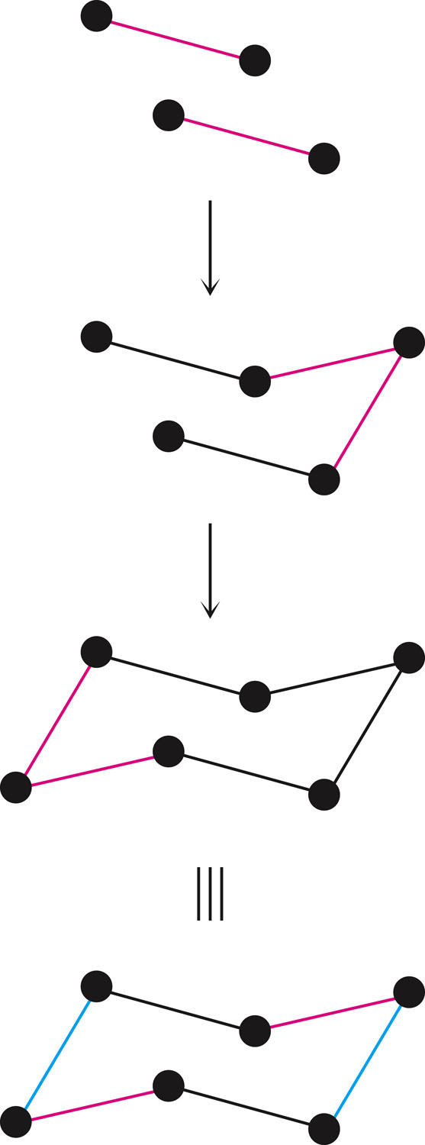
Steps to Draw Chair Conformation of Cyclohexane
Draw two parallel lines, slanted downward and slightly offset from each other
Means that four of the cyclohexane carbons lie in a plane.
Place the topmost carbon atom above and to the right of the plane of the other four, and connect the bonds.
Place the bottommost carbon atom below and to the left of the plane of the middle four, and connect the bonds
Note that the bonds to the bottommost carbon atom are parallel with the bonds to the topmost carbon.
Notes:
Conformations of cyclohexane

Slide 30
Alternate Conformation of Cyclohexane
Boat cyclohexane: Conformation of cyclohexane that bears a slight resemblance to a boat
No angle strain
Large number of eclipsing interactions
Twist-boat conformation: Conformation of cyclohexane that is somewhat more stable than a pure boat conformation
Nearly free of angle strain
Notes:
Conformations of cyclohexane

Slide 31
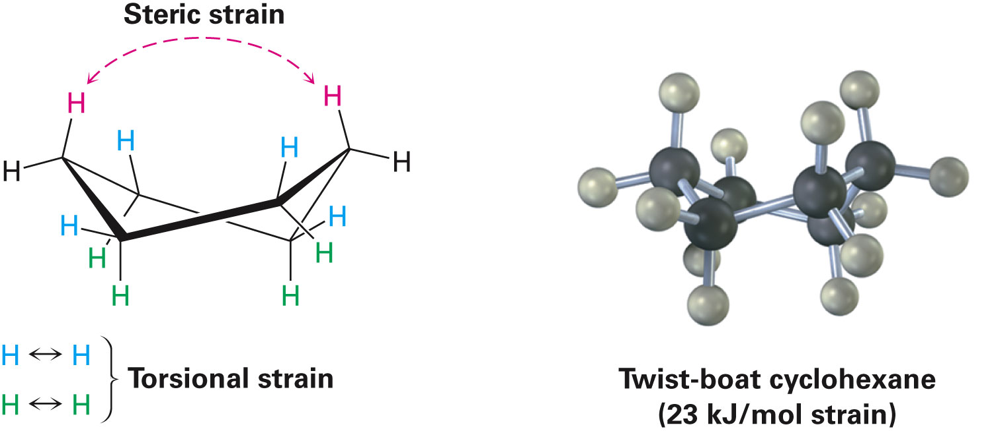
Alternate Conformation of Cyclohexane
Notes:
Conformations of cyclohexane

Slide 32
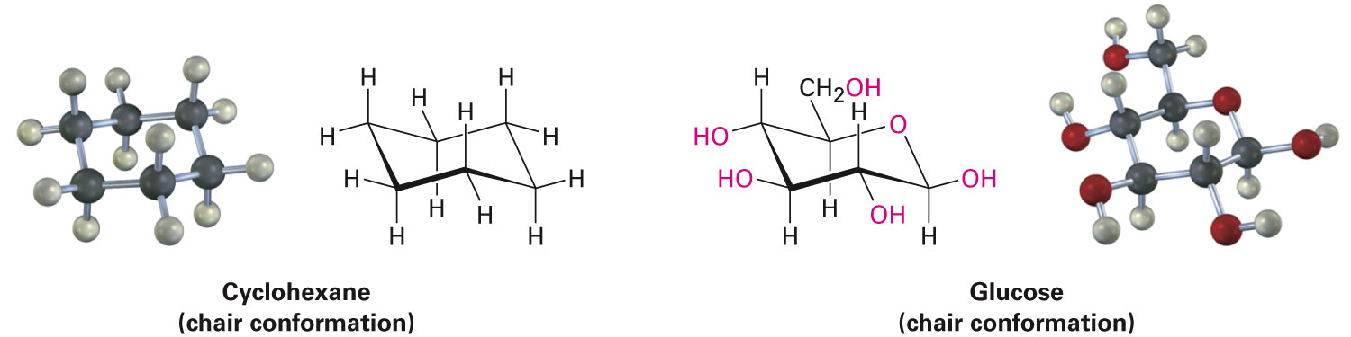
Axial and Equatorial Bonds in Cyclohexane
Chair conformation positions for substituents on the ring
Axial positions
Equatorial positions
Chair cyclohexane has six:
Axial hydrogens perpendicular to the ring
Equatorial hydrogens near the plane of the ring
Notes:
Axial and equatorial bonds in cyclohexane

Slide 33
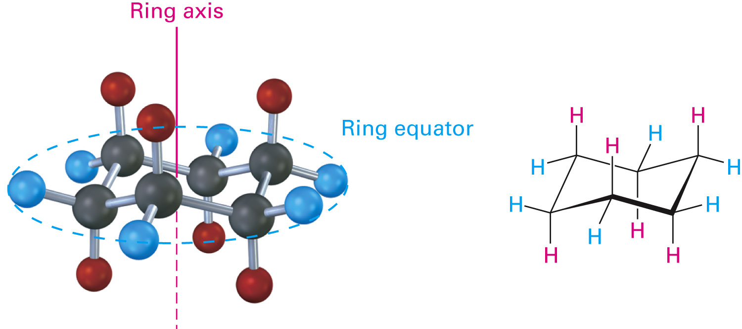
Figure 4.8 - Axial and Equatorial Positions in Chair Cyclohexane
Notes:
Axial and equatorial bonds in cyclohexane

Slide 34
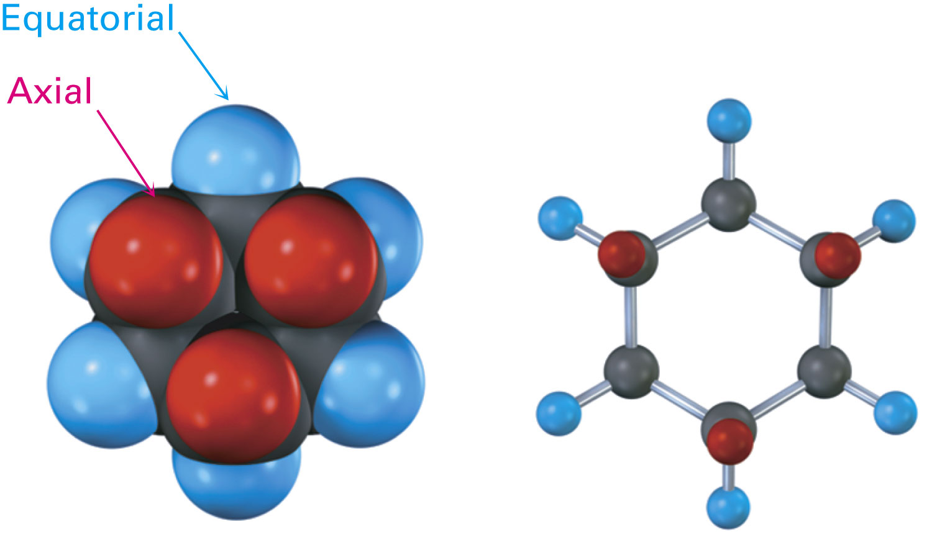
Axial and Equatorial Positions
Each carbon atom in cyclohexane has one axial and one equatorial hydrogen
Each face of the ring has three axial and three equatorial hydrogens in an alternating arrangement
Notes:
Axial and equatorial bonds in cyclohexane

Slide 35
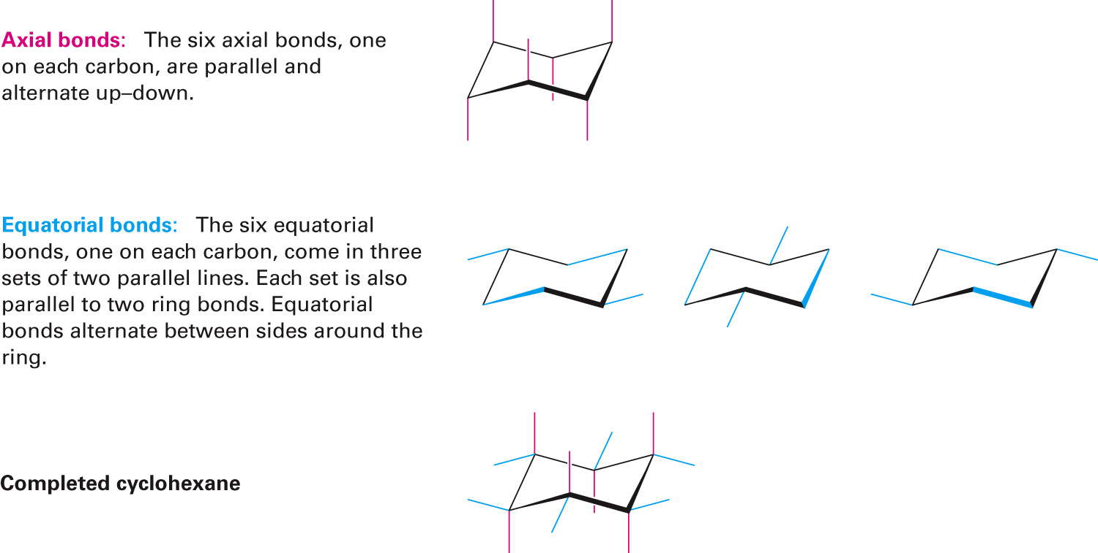
Figure 4.10 - A Procedure for Drawing Axial and Equatorial Bonds in Chair Cyclohexane
Notes:
Axial and equatorial bonds in cyclohexane

Slide 36
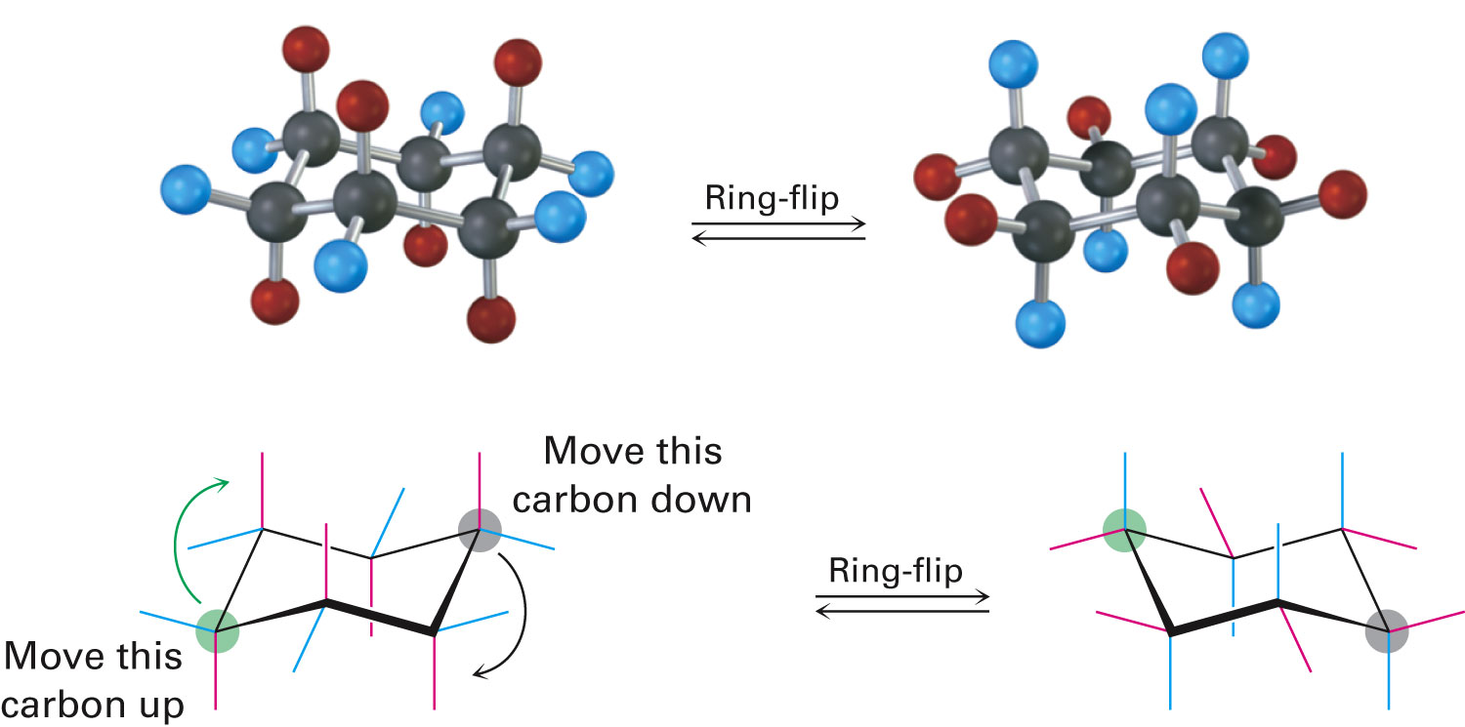
Conformational Mobility of Cyclohexane
Ring-flip: Interconversion of chair conformations, resulting in the exchange of axial and equatorial positions
Notes:
Axial and equatorial bonds in cyclohexane

Slide 37
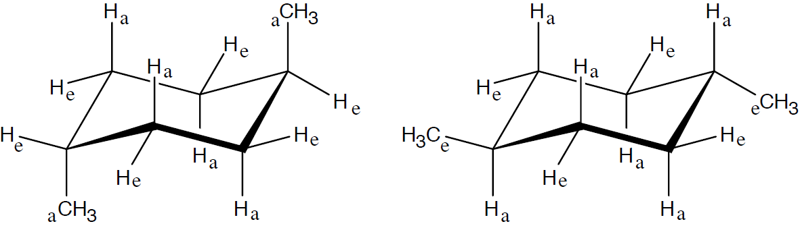
Worked Example
Draw two different chair conformations of trans-1,4-dimethylcyclohexane
Label all positions as axial or equatorial
Solution:
Methyl substituents are either both axial or both equatorial
trans-1,4-dimethylcyclohexane
Notes:
Axial and equatorial bonds in cyclohexane

Slide 38
Conformations of Monosubstituted Cyclohexanes
Cyclohexane ring rapidly flips between chair conformations at room temperature
Two conformations of monosubstituted cyclohexane aren’t equally stable
Equatorial conformer of methyl cyclohexane is more stable than the axial by 7.6 kJ/mol
Substituent is more stable in an equatorial position than in an axial position
Notes:
Conformations of monosubstituted cyclohexanes

Slide 39
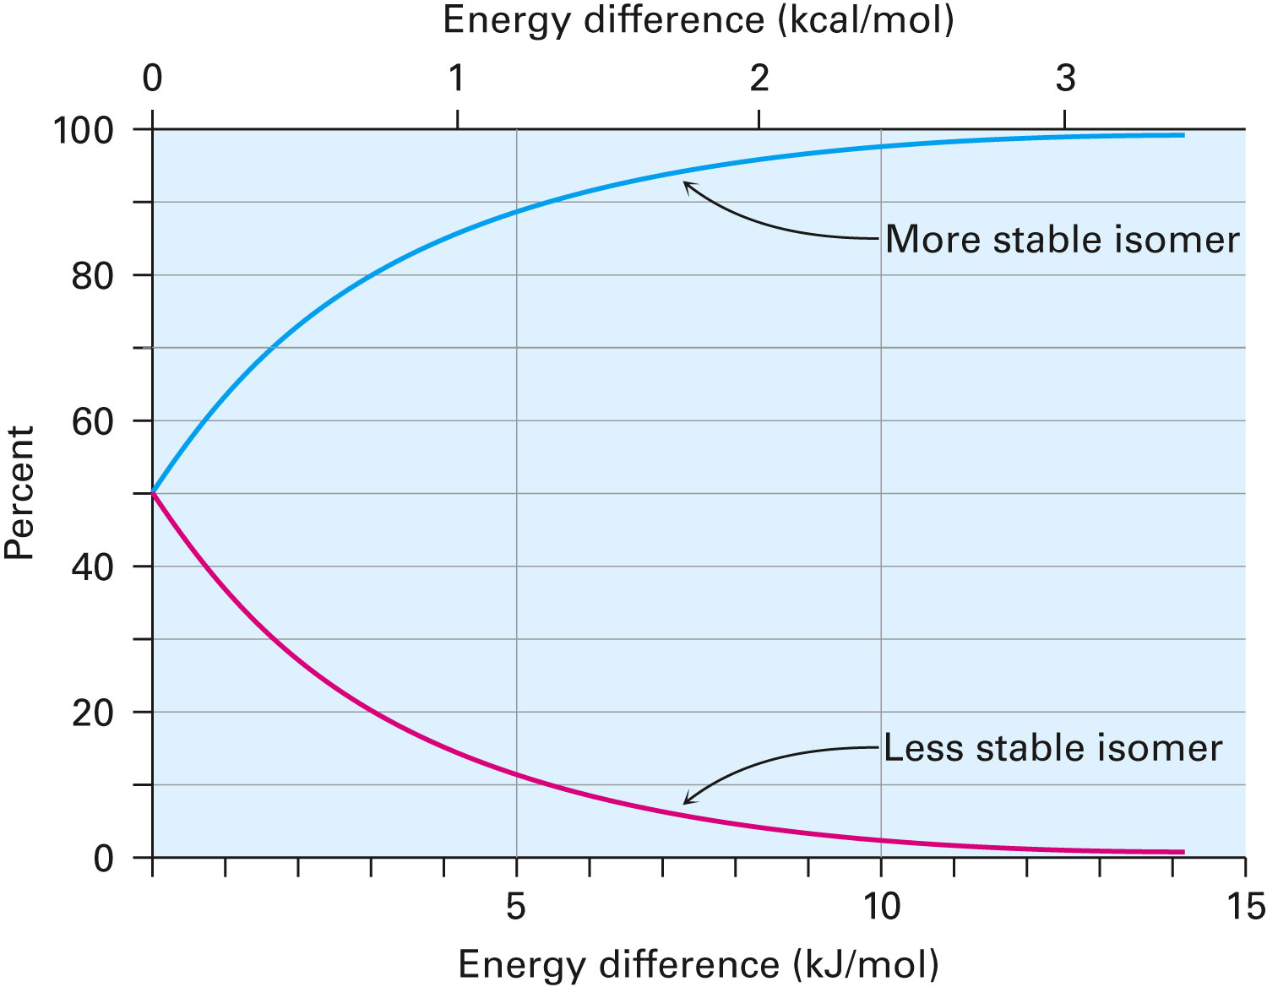
Figure 4.12 - A Plot of the Percentages of Two Isomers at Equilibrium Versus the Energy Difference Between Them
Notes:
Conformations of monosubstituted cyclohexanes

Slide 40
1,3-Diaxial Interactions
Causes steric strain
Steric strain - Causes difference between axial and equatorial conformers
Hydrogen atoms of the axial methyl group on C1 are too close to the axial hydrogens three carbons away on C3 and C5
Results in 7.6 kJ/mol of steric strain
Notes:
Conformations of monosubstituted cyclohexanes

Slide 41
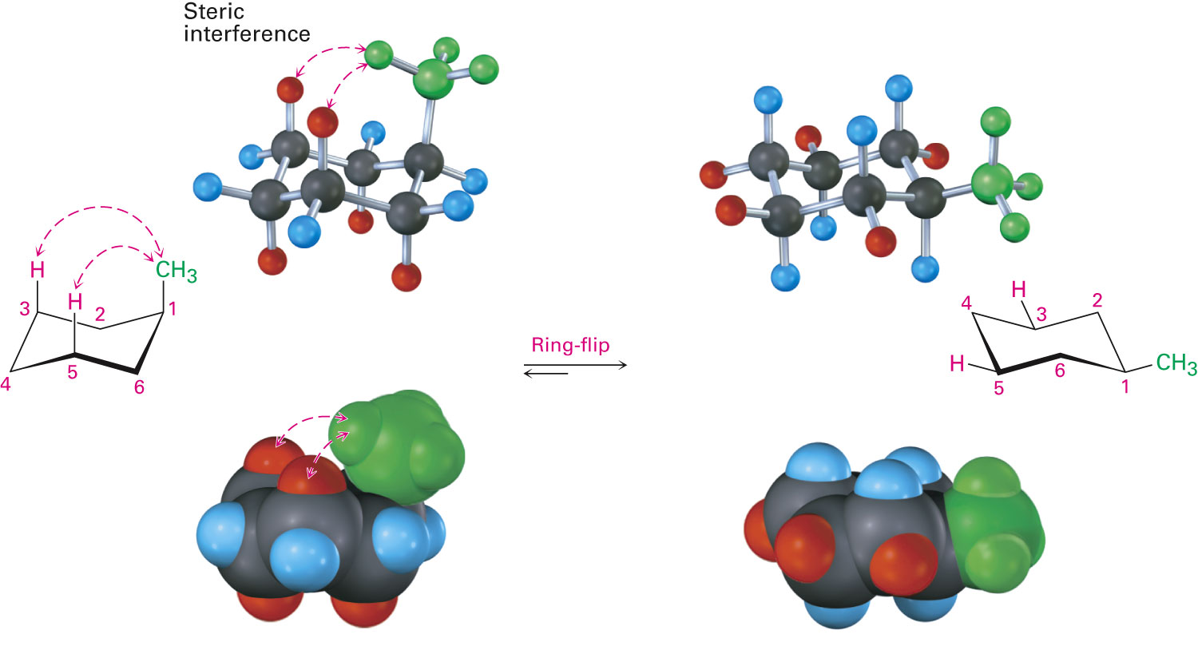
Figure 4.13 - Interconversion of Axial and Equatorial Methylcyclohexane
Notes:
Conformations of monosubstituted cyclohexanes

Slide 42
Relationship to Gauche Butane Interactions
Gauche butane is less stable than anti butane by 3.8 kJ/mol due to steric interference between hydrogen atoms on the two methyl groups
Four-carbon fragment of axial methylcyclohexane and gauche butane have the same steric interaction
Equatorial methylcyclohexane has no such interactions
More stable

Slide 43
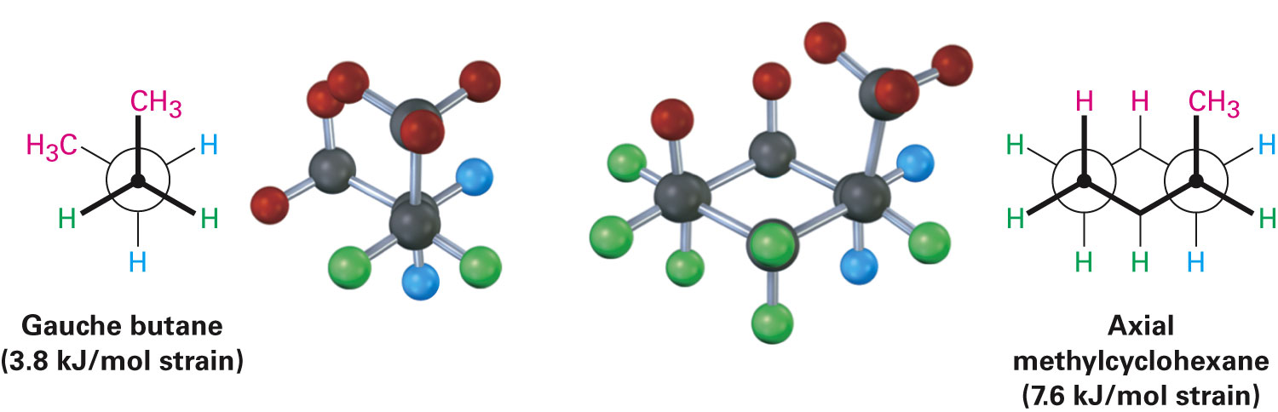
Figure 4.14 - The Origin of 1,3-Diaxial Interactions in Methylcyclohexane
Notes:
Conformations of monosubstituted cyclohexanes

Slide 44
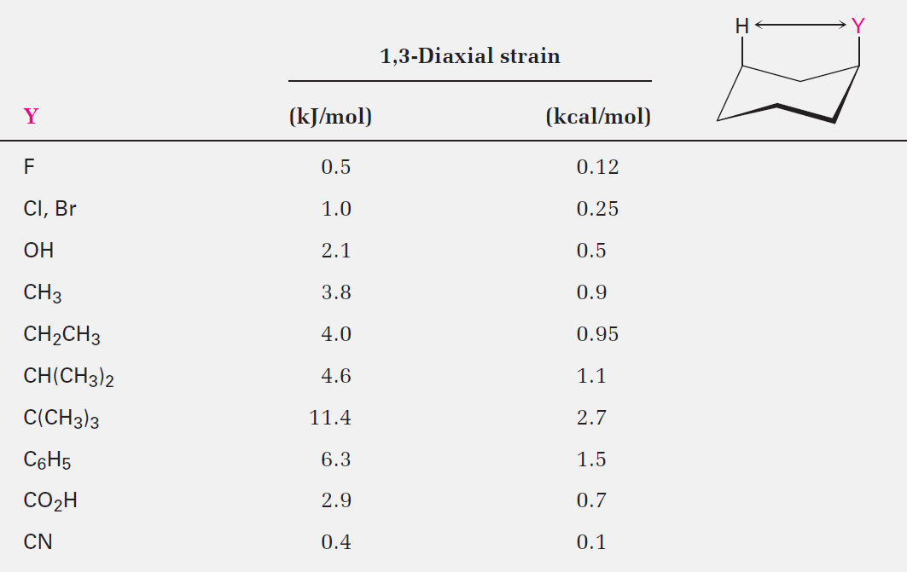
Table 4.1 - Steric Strain in Monosubstituted Cyclohexanes
Notes:
Conformations of monosubstituted cyclohexanes

Slide 45
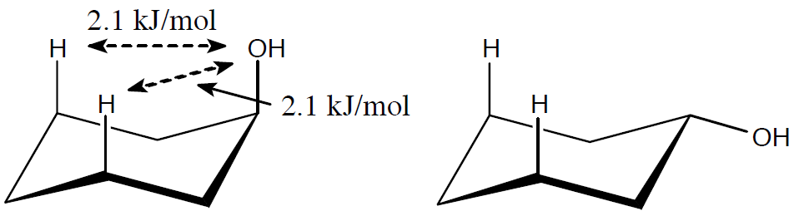
Worked Example
What is the energy difference between the axial and equatorial conformations of cyclohexanol (hydroxycyclohexane)?
Solution:
An axial hydroxyl group causes 2 x 2.1 kJ/mol of steric strain (From Table 4.1)
Energy difference between axial and equatorial cyclohexanol is 4.2 kJ/mol
Notes:
Conformations of monosubstituted cyclohexanes

Slide 46
Conformations of Disubstituted Cylcohexanes
Steric effects of both substituents is taken into account in both conformations
Isomers of 1,2-dimethylcyclohexane
Cis-1,2-dimethylcyclohexane
Trans-1,2-dimethylcyclohexane
Cis isomer
Both methyl groups are on the same face of the ring
Compound can exist in two chair conformations
Notes:
Conformations of disubstituted cyclohexanes

Slide 47
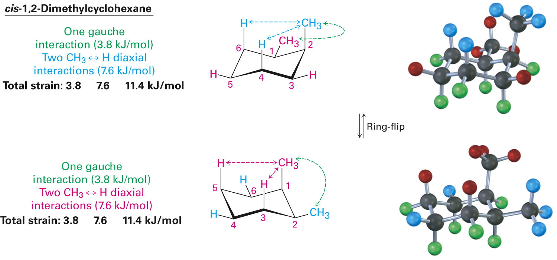
Figure 4.15 - Conformations of cis-1,2-dimethylcyclohexane
Notes:
Conformations of disubstituted cyclohexanes

Slide 48
Conformations of Disubstituted Cylcohexanes
Trans isomer
Methyl groups are on opposite faces of the ring
One trans conformation has both methyl groups equatorial and only a gauche butane interaction between methyls (3.8 kJ/mol)
No 1,3-diaxial interactions
Ring-flipped conformation has both methyl groups axial with four 1,3-diaxial interactions
Will exist almost exclusively in diequatorial conformation
Notes:
Conformations of disubstituted cyclohexanes

Slide 49
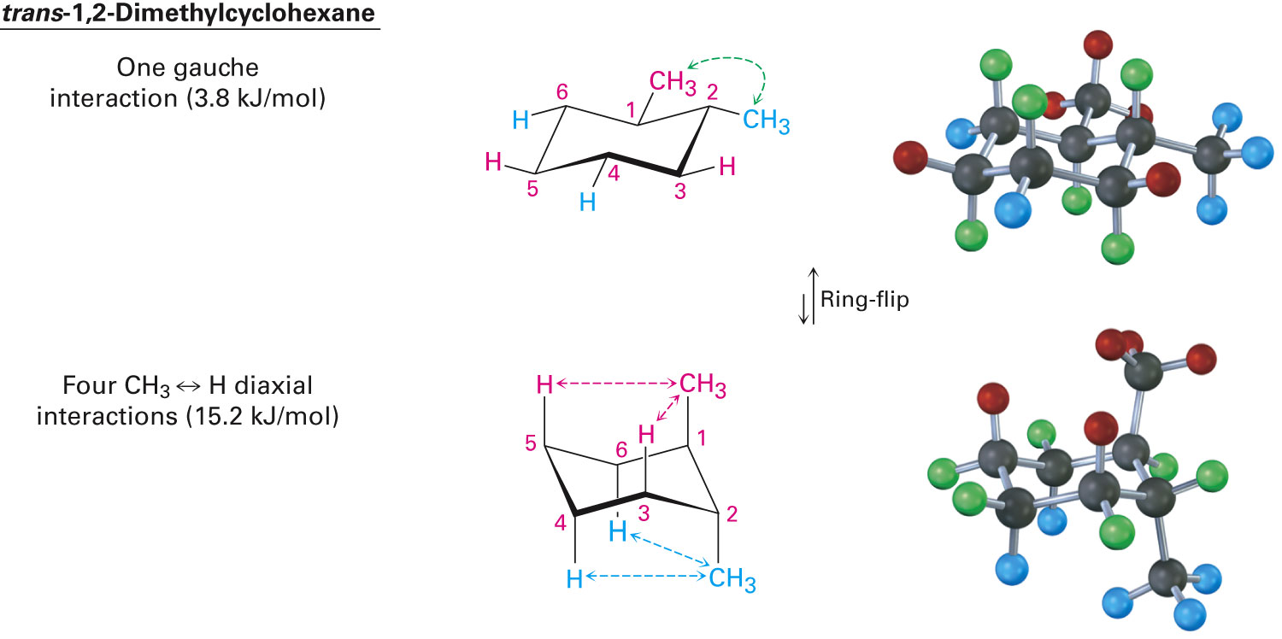
Figure 4.16 - Conformations of trans-1,2-dimethylcyclohexane
Notes:
Conformations of disubstituted cyclohexanes

Slide 50
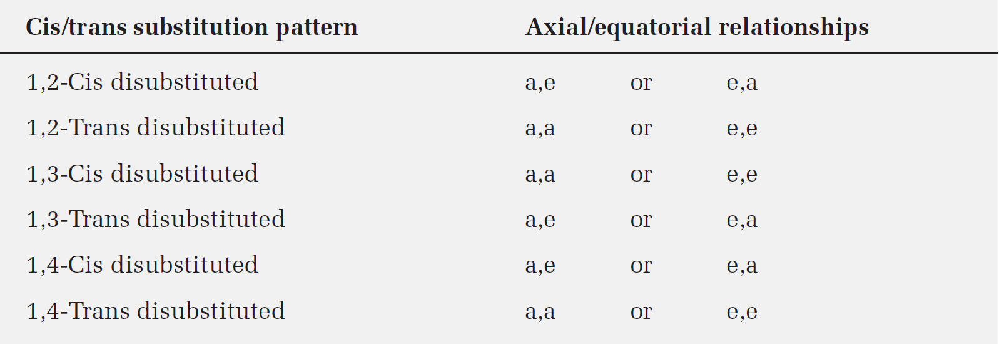
Table 4.2 - Axial and Equatorial Relationships in Cis- and Trans-Disubstituted Cyclohexanes
Notes:
Conformations of disubstituted cyclohexanes

Slide 51
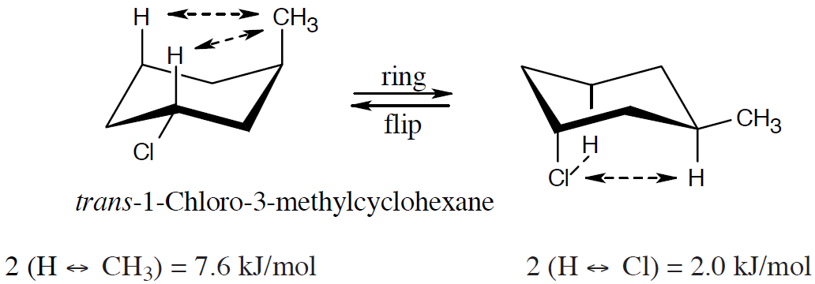
Worked Example
Draw the more stable chair conformation of the following molecules
Estimate the amount of strain in each
a) trans-1-Chloro-3-methylcyclohexane
b) cis-1-Ethyl-2-methylcyclohexane
Solution:
a) trans-1-Chloro-3-methylcyclohexane
Notes:
Conformations of disubstituted cyclohexanes

Slide 52
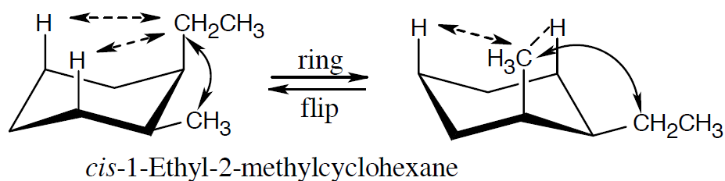
Worked Example
The second conformation is more stable than the first
b) cis-1-Ethyl-2-methylcyclohexane
One CH₃ ↔ CH₂CH₃ gauche
Interaction = 3.8 kJ/mol
2 (H–CH₂CH₃) = 8.0 kJ/mol
Total = 11.8 kJ/mol
Notes:
Conformations of disubstituted cyclohexanes

Slide 53
Worked Example
One CH3 ↔ CH2CH3 gauche
Interaction = 3.8 kJ/mol
2 (H–CH₃) = 7.6 kJ/mol
Total = 11.4 kJ/mol
The second conformation is slightly more stable than the first
Notes:
Conformations of disubstituted cyclohexanes

Slide 54
Conformations of Polycyclic Molecules
Decalin consists of two cyclohexane rings joined to share two carbon atoms and a common bond
Isomeric forms of decalin are trans fused or cis fused
In cis-decalin, hydrogen atoms at the bridgehead carbons are on the same face of the rings
In trans-decalin, the bridgehead hydrogens are on opposite faces
Can be represented using chair cyclohexane conformations
Not interconvertible by ring-flips or other rotations
Notes:
Conformations of polycyclic molecules

Slide 55
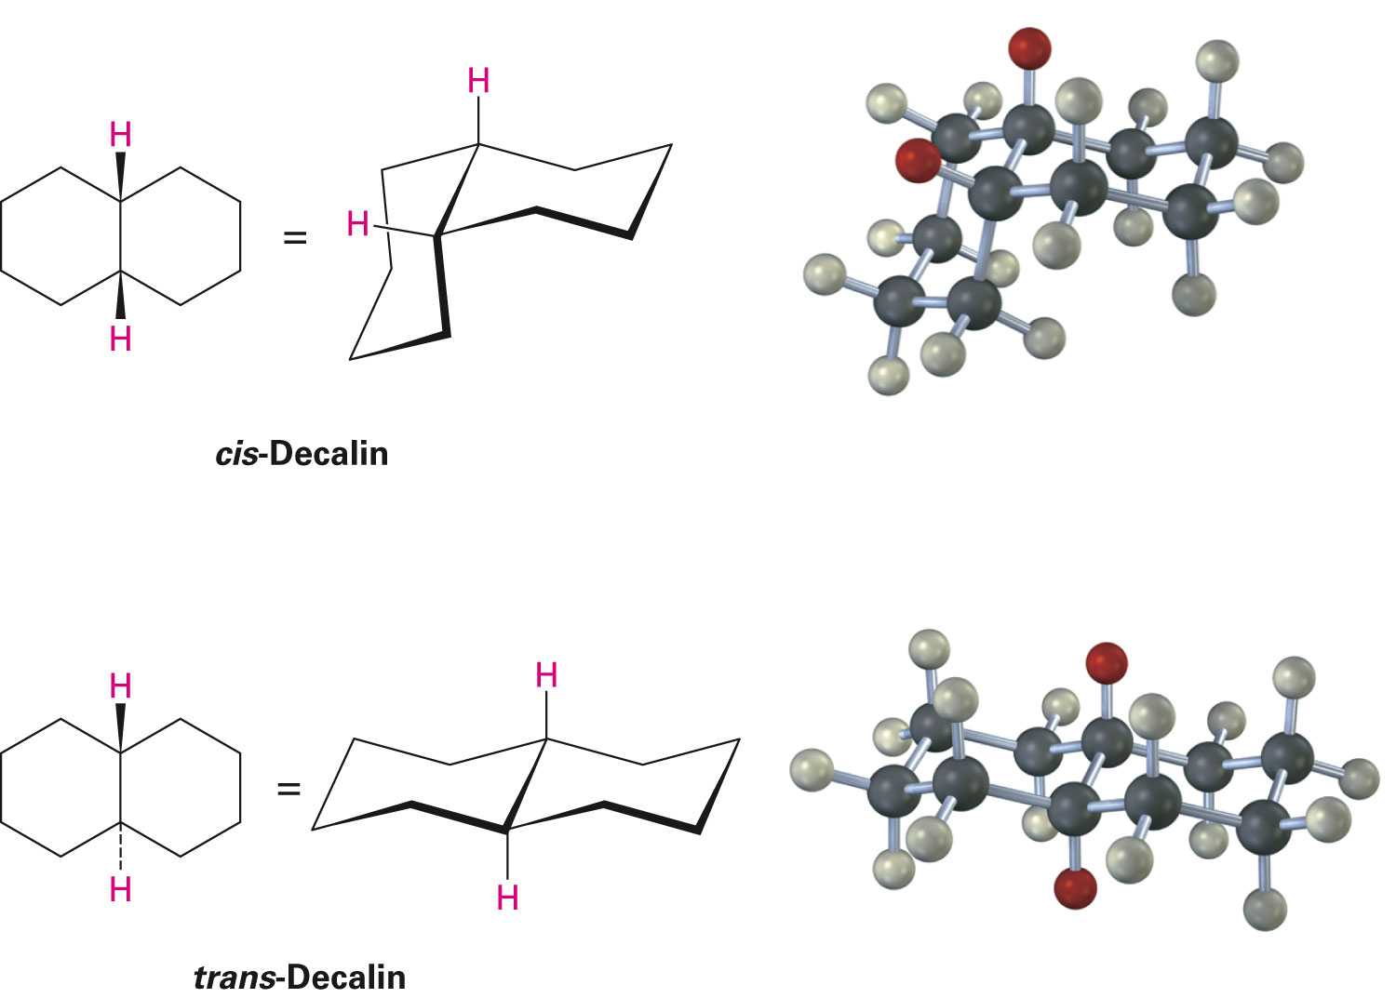
Figure 4.17 - Representations of cis- and trans-decalin
Notes:
Conformations of polycyclic molecules

Slide 56
Conformations of Polycyclic Molecules
Norbornane, or bicyclo[2.2.1]heptane, structure
Molecule has seven carbons and three bridges of 2, 2, and 1 carbon atoms
Has a conformationally locked boat cyclohexane ring
Notes:
Conformations of polycyclic molecules

Slide 57
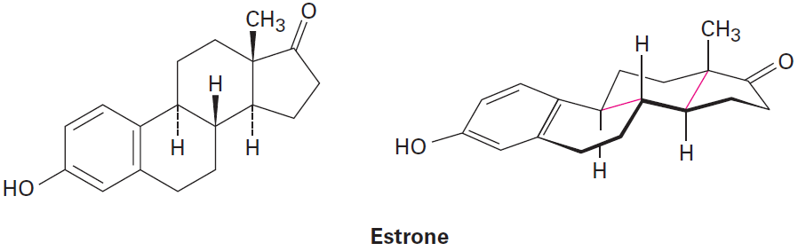
Worked Example
Identify weather each of the two indicated ring-fusions is cis or trans
Solution:
Both ring fusions are trans
The bridgehead groups are on opposite faces of the fused ring system
Notes:
Conformations of polycyclic molecules

Slide 58
Summary
Cycloalkanes are saturated cyclic hydrocarbons with the general formula C_{n}H_{2n}
Disubstituted cycloalkanes can exist as cis-trans isomers
Stereoisomers are compounds that have the same connections between atoms but different 3-D arrangements
Not all cycloalkanes are equally stable
Three kinds of strain contribute to the overall energy of a cycloalkane: Angle strain, torsional strain, and steric strain

Slide 59
Summary
Cyclohexane adopts a puckered chair conformation and hence is strain free
Chair cyclohexanes have two positions: Axial and equatorial
Chair cyclohexanes are conformationally mobile and are capable of undergoing a ringflip
Axial substituents cause 1,3-diaxial interactions making substituents on the ring more stable in the equatorial position

